Slide 1

Teaching Black High School Students How to Write Essays that
Pass the ACT, the SAT, the Advanced Placement English Tests, and
Occasionally Win Contests
“Remediation crushes; challenge fortifies. Where students are valued and challenged, they are likely to succeed” (p. 185, Delpit, 2012).
A Presentation by Debra Johnson
Wednesday, April 16, 2014

Slide 2
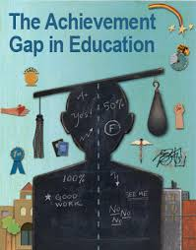
How You Have Been Misinformed about Black Students
When you were in college at the undergraduate level or the graduate level, you were repeatedly told about the ACHIEVEMENT GAP.
Will someone please review what the ACHIEVEMENT GAP is?

Slide 3

There is an ACHIEVEMENT GAP between Black students and other students, but it does not begin in school. It begins at birth.
When Black babies are born, their IQs are ALWAYS higher than other babies’ IQs. They are born more intellectually advanced, and they maintain this lead until they reach age two, when a different, language-based test is used to measure intelligence (Delpit, 2012).

Slide 4

Black children are exposed to several powerful influences that may negatively impact their naturally high IQs:
Mis-education due to black and white teachers who have low intellectual expectations of black students’ academic abilities (Woodson, 1933).
Black children are constantly remediated by instructors, which limits their exposure to advanced topics and increases their boredom. Dr. Denise Davis-Cotton overcame this hurdle by having a strong Advanced Placement program at DSA. (ACT scores at DSA have steadily dropped since her departure).
African American History Month which primarily focuses on slavery, and ignores black peoples’ international and ancient history before slavery. When black historian Dr. Carter G. Woodson created Negro History Week, his intent was to increase, not narrow, black students’ knowledge of their people’s history.
Most students are descended from American slaves, who were forbidden by law to learn how to read or write for multiple generations. Most students do not know the first people on the planet to read and write were called the Sumerians (or the Mesopotamians who lived at Ur), a black people who called themselves “the blackheads” (Kramer, 1959).

Slide 5
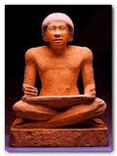
Europe’s Intellectual Debt to African Egypt
“Europe, which received from ancient Egypt the elements of the arts and sciences, is yet further in her debt for the inestimable benefit of alphabetic writing” stated Jean Francois Champollion (p. 169, 1966), the Frenchman who translated the Rosetta Stone.
Black students still do not realize that black people invented math, science, and literacy (James, 1954).
They also don’t know that most of the Egyptians’ ideas (specifically writing) came from black people inside and near ancient Africa (Finch, 1994).
Black students’ lack of knowledge of their ancestors’ creation of literacy may cause them to disidentify or disengage from reading and writing activities.
Black Egyptian Scribe

Slide 6

Before I teach black students how to write essays, I teach them:
Writing is part of their intellectual heritage.
The letters in the alphabet we use today were invented by an ancient black people called the Canaanites.
Reading was invented by black people a very long time ago
Since reading and writing are part of their heritage, there is no reason why they can’t learn to write essays!

Slide 7
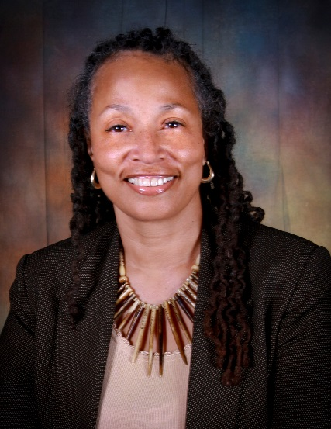
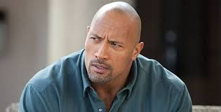
Skeletons: The Tools I Use to Teach Essays
Duane Johnson, but not my brother
Debra Johnson
A skeleton is the essay outline I created during the ‘90s when I was teaching adult education in Ferndale. The GED administration had begun to require candidates to write essays. Since the average adult education student reads at the fourth grade level, there was a challenge.
I have invented a variety of skeletons, but the most useful are the basic essay skeleton and the ACT essay skeleton.
My method is to have students write so many essays using skeletons that the structure becomes embedded in their minds. After writing about nine essays, students have mastered the basic essay and ACT essay structure.
You have my permission to duplicate my copyrighted skeleton for educational purposes. However, if you publish it or use it for any other circumstances, you will be meeting my brother Duane, the attorney.

Slide 8

The Philosophy behind the Skeletons
The purpose of the skeletons is:
To prepare the students for their freshman composition class in college. The basic essay skeleton can be used for the SAT, the AP English tests, and most essay contests. It is not designed to teach to any test—it is designed to teach beyond standardized tests.
To prepare for the ACT. The ACT essay skeleton is the basic essay skeleton plus one paragraph that contains an opposing viewpoint. It is designed exclusively for the ACT, and my students have received the score of 12, which is the highest possible writing score.
To prepare the students for writing research papers. I tell students that the research paper is the basic essay stretched out.

Slide 9

How I Teach Students to Use the Basic Essay Skeleton
I have created a series of videos that demonstrate how I use the basic essay skeleton to teach a class how to write the five paragraph essay.
These videos were filmed over two days in November 2008 after the presidential election. The filming occurred at Southeastern High School in Detroit with a second hour tenth grade English class.
They are available at www.teachertube.com. Type the term djohnsonish into the search engine. The six videos of five to 20 minutes correspond to sections of the basic essay skeleton.

Slide 10

References
Champollion, J. F. (1966). Champollion Deciphers the Hieroglyphs. In C. W. Ceram’s (Ed.) Hands on the Past: Pioneer Archaeologists Tell Their Own Story. New York: Alfred A. Knopf.
Delpit, L. (2012). “Multiplication is for White People:” Raising Expectations for Other People’s Children. New York: The New Press.
Finch, C. S. (1994). Nile Genesis: Continuity of Culture from the Great Lakes to the Delta. In Ivan Van Sertima’s (Ed.) Egypt: Child of Africa. New Brunswick: Transaction Publishers.
James, G. M. (1954). Stolen Legacy. San Francisco: Julian Richardson Associates.
Kramer, S. N. (1959). History Begins at Sumer. New York: Doubleday Anchor Books.
Woodson, C. G. (1933). The Mis-education of the Negro. Washington, D.C.: Africa World Press.

